Slide 1
End of Life High Fidelity Simulation: The Use of Studiocode for Video Analysis
Priscilla Cunningham, BSc(Hons), RGN
PhD Candidate, School of Nursing and Midwifery
Queen’s University Belfast
Supervisory Team: Dr Joanne Reid, Dr Helen Noble, Dr Claire Lewis

Slide 2
Overview
Background and Study Rationale
Study Design
Video Analysis Using Studiocode
Pros and Cons of Studiocode
Summary

Slide 3


Background and Study Rationale
National guidelines and policies: Guidance for end of life care in adults (NICE, 2017); End of Life Care Strategy: Promoting high quality care for adults at the end of their life (DoH, 2008).
End of life care has been reported as sub-optimal in many areas including in communication and information-giving (Reid et al, 2009) and symptom control and emotional support (Gallagher and Krawczyk, 2013).
Studies report that nursing and medical students and newly qualified staff feel inadequately prepared to provide quality care to patients at end of life and support to their families (Hopkinson et al, 2005; Cavaye and Watts, 2010; Bowden et al, 2013).
Findings from a literature review (Gillan et al, 2014) report simulation to be a viable approach to delivering end of life care education.

Slide 4
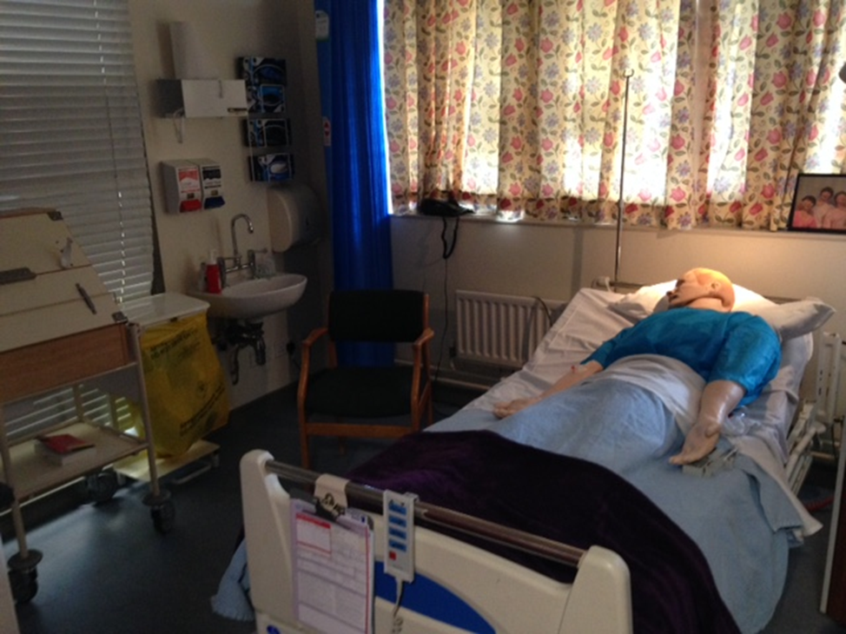
Study Design
Aim: To investigate the use of high fidelity simulation in undergraduate interprofessional education to deliver end-of-life education to nursing and medical students.
Mixed-methods design with three phases of data collection and analysis:
Pre and post-intervention questionnaire
Focus groups
Video recordings

Slide 5


Video Analysis Using Studiocode
Product of Vosaic https://vosaic.com/products/studiocode
Customised video tagging enables identification of key moments.
Cross-referencing and analysis assisted by creation of timelines, databases and transcription texts.
‘User self-discovery’ allows users to identify if their performance is affecting the outcomes of their research.

Slide 6
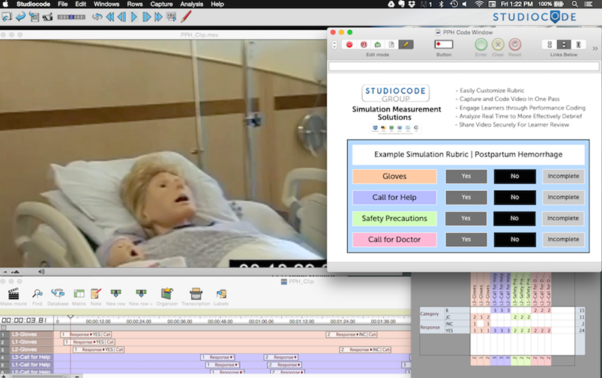

Slide 7
Pros and Cons of Studiocode
Pros | Cons
Designed with relevancy to healthcare education | Requires an inductive approach if analysis is qualitative
Opportunities for further quantitative data and publications | License expense and operating system restrictions
Straightforward method of assisting video analysis | Other methods of video analysis appropriate for qualitative analysis

Slide 8
Summary
Vosaic Studicode is an effective method to assist video analysis.
Limitations on its use in the current study.
Opportunities for future use of Studiocode for video analysis of high fidelity end of life simulation.

Slide 9
References
Bowden, J., Dempsey, K., Boyd, K., Fallon, M., Murray, S.A. (2013) ‘Are newly qualified doctors prepared to provided supportive and end of life care? A survey of foundation year 1 doctors and consultants’, Journal of the Royal College of Physicians of Edinburgh, 43(1), pp. 23–28.
Cavaye, J. and Watts, J.H. (2010) End of life education in the pre-registration nursing curriculum. Journal of Research in Nursing, 17(4), pp. 317-326.
Department of Health (2008) End of Life Care Strategy: Promoting high quality care for all adults at the end of life, London: Department of Health.
Gallagher, R. Krawczyk, M (2013) Family members’ perceptions of end of life care across diverse locations of care. BMC Palliative Care 12(25)
Hopkinson, J.B., Hallett, C.E., Luker, K.A. (2005) ‘Everyday death: How do nurses cope with caring for dying people in hospital?’, International Journal of Nursing Studies, 42(2), pp. 125–133
National Institute for Health and Care Excellence (2017) End of life care for adults, available at: https://www.nice.org.uk/guidance/qs13/chapter/Introduction-and-overview (Accessed: 29th March 2017).

