Slide 1
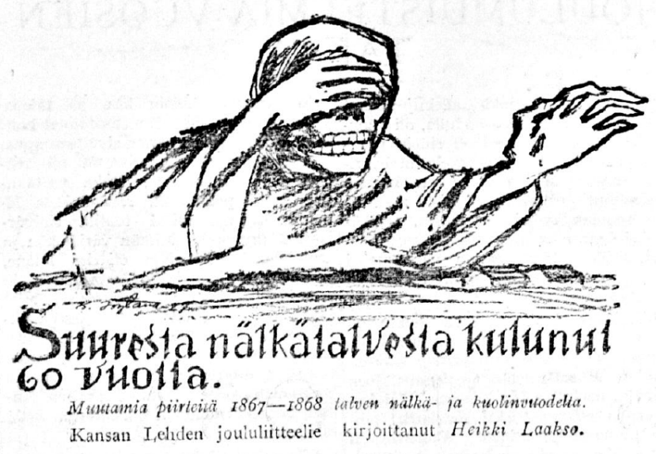
“Death had lost its meaning”
Remembering the Great Finnish Famine
Andrew G. Newby andrew.newby@uta.fi

Slide 2
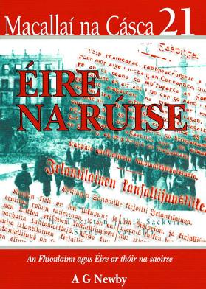
Famine Memorials in Finland and Ireland
Overview: Finland 1809-1860s
potential for use as comparator with Ireland.
The “Great Famines” – Ireland (1840s), Finland (1860s).
Finland’s “Great Hunger Years” Memorials:
Basis for the research
Locations
Themes in Finnish Memorials: symbols, locations, materials etc.
What might Finland’s memorials tell us about:
(i) Finland’s local and national identities
(ii) Ireland’s famine narrative.

Slide 3
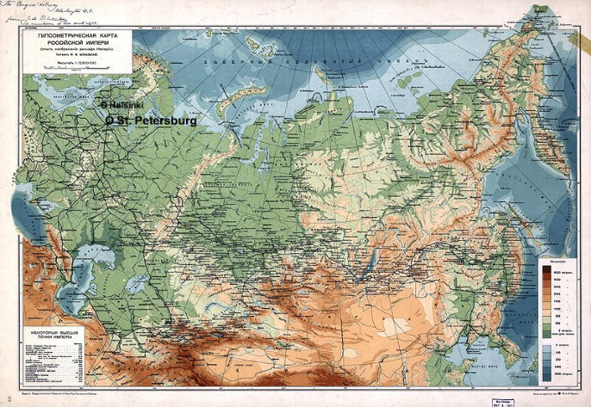
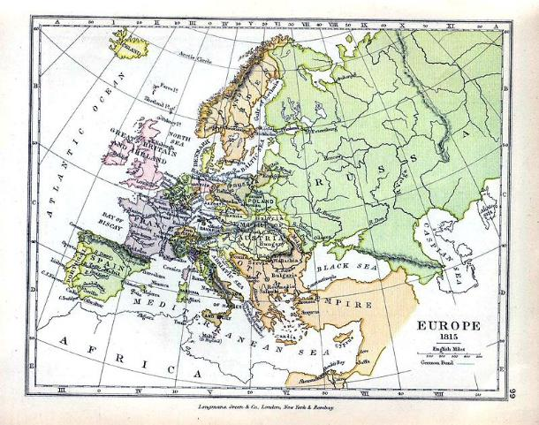
“Finland:
Between East and West”
-The 1860s were a time of great social and political upheaval in Europe and its various Empires.
-International recognition of recurrent and regular famine.
-In late 1867 Finland, Sweden and the Baltic States are all affected by the climate.

Slide 4
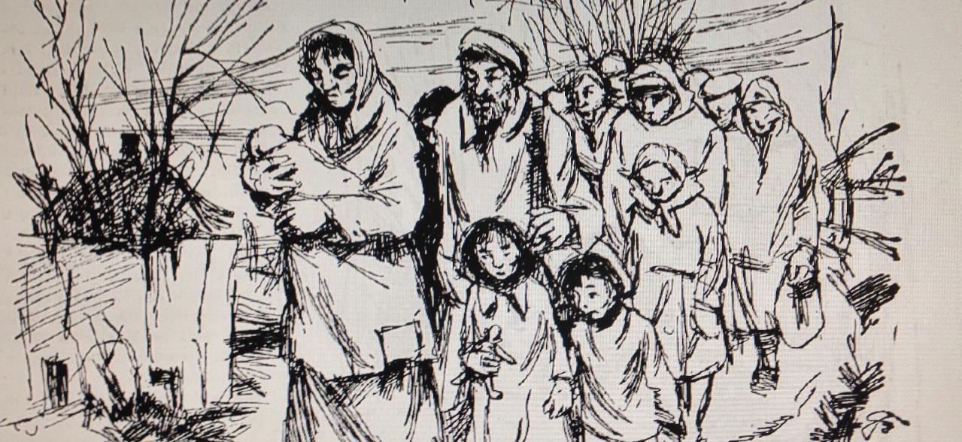
The Great Finnish Famine: Causes and Contexts
1809: Finland becomes an autonomous “Grand Duchy” within the Russian Empire, after centuries as part of the Swedish Kingdom. “Swedish” civil society (laws, religion, language) remains as before.
1812: Helsinki replaces Turku as capital city. Bank of Finland established. 1828: University moved from Turku -> Helsinki. (counterfactual comparison? – Napoleon wins in 1815, Irish promoted over English, everything moved to Cork…)
During these years, there is a slow, “top-down” growth of a distinct Finnish national identity (encapsulated as “Swedes we are no longer, Russians we will never become, therefore let us be Finns!”), and increase in interest in the Finnish language.
International trade increases (e.g. establishment (1820) of Tampere by James Finlayson, Quaker Scot.)
Internal shift in economic actvity from west coast to south coast.
St. Petersburg accepts autonomy -- moving away from Sweden, not making any claims on the imperial treasury.
Finnish language, omavaraisuus (self-sufficiency) and sivistys (education) become the key planks of the Finns’ national identity. Kalevala published in 1835.
Illustration by Olavi Hurmerinta. Maaseudun Tulevaisuus, 16 Mar. 1950

Slide 5
The Great Finnish Famine: Causes and Contexts
1850s:
Context of “Pan-Scandinavism” – how does Finland relate to Scandinavia?
Crimean War – Finland a “legitimate target” of the British Navy as part of Russian Empire. But widespread unease in Britain and “Famine Relief Fund” established by Quakers as a means of reparation.
1860s:
1860: New “national” currency, the mark, replaces the rouble.
Desperate harvest failure again in 1862-3. International aid and attention. “Sliding towards disaster”.
1863: Tsar seems to confirm Finland’s position as a “nation” at the Diet. Finnish language given official recognition.
J.V. Snellman leads a hard fiscal policy – limited borrowing – focus on self-sufficiency.
1867
“Famine” (hungersnöd / nälänhätä) already reported in previous years. The night frost of 3-4 Sep. 1867 destroyed another harvest.
Grain stores perilously low throughout the country. Landless labourers increased greatly in number and more vulnerable.
Seeds were planted so late in 1867 that it seems unlikely they’d have survived even in a “normal” year – failure of the administration to plan properly? Or misjudged ideological / didactic reasons?
Illustration by Olavi Hurmerinta. Maaseudun Tulevaisuus, 16 Mar. 1950

Slide 6
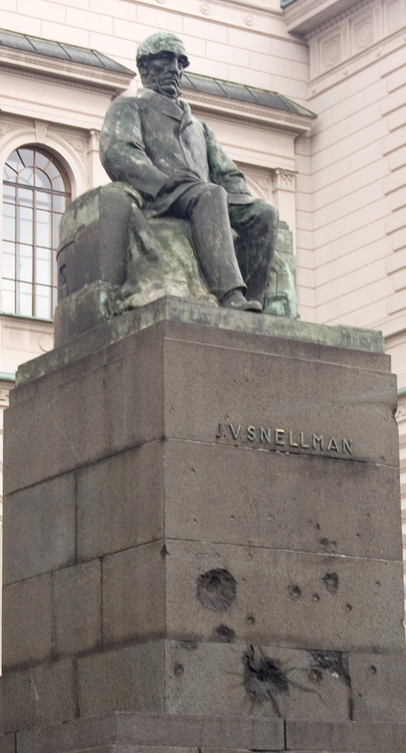
I have already referred several times to the Finnish famine of 1867-8 for comparative perspective. This was truly the ‘last great subsistence crisis of the western world.’ The Irish famine surpassed the Finnish in its intensity, in its duration, and in its long-term impact. In Finland, about 0.1 million out of a population of 1.6 million died, in Ireland one million out of 8.5 million. In Finland, the crisis was limited to one bad year, in Ireland excess mortality was substantial for four years. In Finland, the cereal crops failed badly once; in Ireland, the potato failed disastrously several times, and took half a century to regain its pre-Famine vigour. The roles of politics and relief seem to loom much larger in the historiography of the Irish than the Finnish famine, perhaps because London was much closer to events, both geographically and administratively, than Moscow. In other ways, there are obvious parallels and contrasts worth pursuing: different impact by region, the causes of death and the variation in deaths by age and sex, the functioning of markets and communication networks. In both countries, politicians and bureaucrats have been blamed, and rightly so, for acting in a doctrinaire and ungenerous fashion. In the wake of the First World War, both Ireland and Finland were prised away from empires that long coveted them. Irish anti-imperial resentment long outlasted Finnish, though perhaps for reasons that had little to do with the Famine
Cormac Ó Gráda, Ireland: A New Economic History 1780-1939 (Oxford, 1994), pp. 208-9.

Slide 7
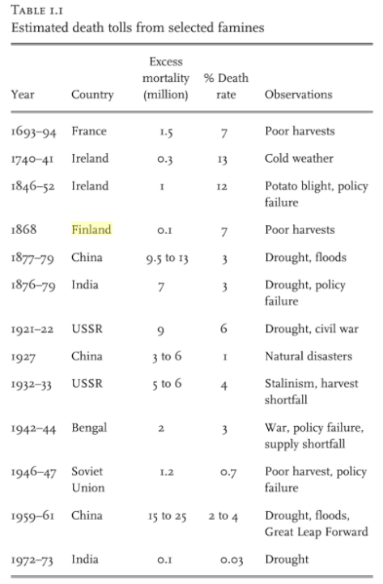
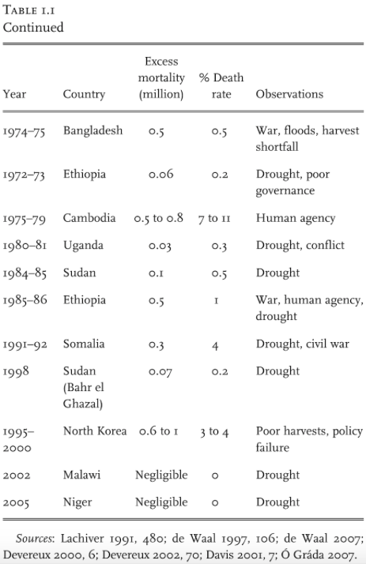
Cormac ó Gráda,
Famine: A Short History
(Princeton UP, 2009),
pp. 23-4.

Slide 8
Source:
STVK 2006, t. 83.
1867-8
“Great Finnish Famine”
1902-3
“Famine”
1808-9
Russo-Swedish War
1856-7
Crimean War & “Famine”

Slide 9
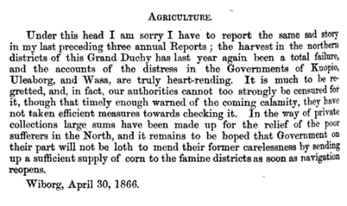
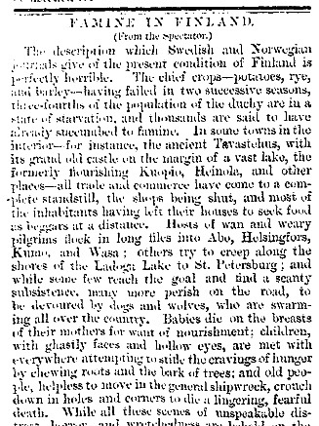
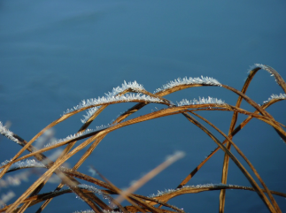
Finland’s 1860s Famine Sliding towards a disaster.
The “frost night” of Sep. 3-4 1867 prompted the final disastrous year of the famine. Culpability was generally shifted on to the “frost” (ie nature, and -> ie God), which suited the administration in Helsinki.
Herman Lorentz, British Consul General at Viborg
Commercial Reports, Received at the Foreign Office from Her Majesty’s Consuls in 1866 (London, 1866), p. 296.
Spectator, 10 Jan. 1863 &
Glasgow Herald, 17 Jan. 1863

Slide 10
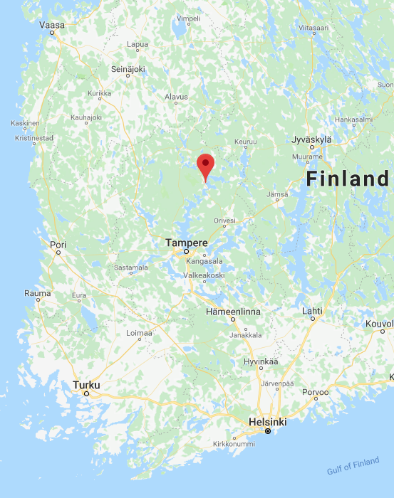
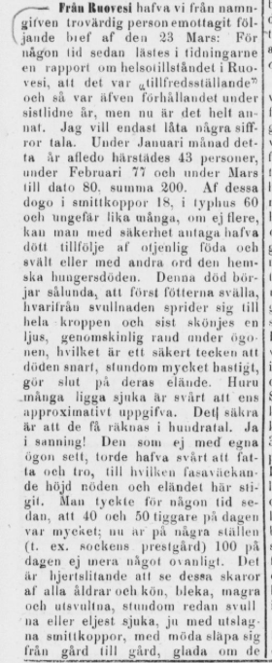
From Ruovesi (23 March 1868): […] In the month of January 43 people died here; in February 77 and in March 80, in total 200. Of these, 18 died of smallpox, 60 of typhus, and about the same number poor nutrition and hunger, in other words, famine. This death begins with swollen feet, from where the swelling spreads to the entire body. And eventually a light, translucent line is seen under the eyes, and that is a sign that death is near. How many people are actually sick is difficult even to contemplate. The sure thing is that it can be reckoned in hundreds. Yes - Really! One has thought for some time that 40-50 beggars a day is a lot. Now in some places (e.g. the parish’s parochial home) 100 per day is no longer unusual.
Report by Ruovesi’s priest, J.W. Durchman
Helsingfors Dagblad, 2 Apr. 1868

Slide 11
In stressing the ‘imperial / colonial dialectic’ in the dynamics of Irish famine relief, William J. Smyth has argued that ‘one could never imagine any Irish Government of whatever hue… turning their backs and ignoring the “cry of want”.’
William J. Smyth, ‘The Longue Durée: Imperial Britain and Colonial Ireland’, in J. Crowley, W.J. Smyth & M. Murphy (eds) Atlas of the Great Irish Famine (Cork, 2012), 63.
… if the [Great Irish] Famine had occurred under an independent Irish parliment, it would have been regarded in a different light. The last major famine in Europe outside Russia was in Finland during the 1860s. Cormac Ó Gráda has noted that ‘the role of politics and relief seem to loom larger in the historiography of the Irish than of the Finnish famine.’ Finland had a devolved government, and responsibility for devising famine relief rested firmly in Helsinki. Finnish nationalism would seem to have led to amnesia, both concerning the famine and the inadequate measures adopted at the time.
Mary E. Daly, ‘Historians and the Famine: A Beleaguered Species?’, Irish Historical Studies, 30 (1997), 596.
Official memorials to the victims of famine are also remarkably rare… I know of just two cases in which mass starvation was memorialized in its immediate aftermath... [Leningrad and Tigray]... What these cases have in common is that a famine is remembered as an element of national narrative. Much more common around the world is official silence, along with local efforts to remember.
Alex de Waal, Mass Starvation: The History and Future of Famine (Cambridge, 2018), 24-5.

Slide 12
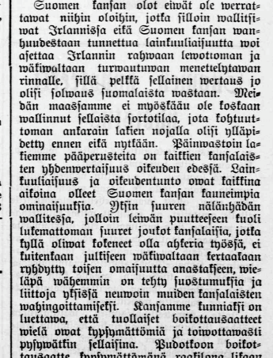
How are the “Great Hunger Years” remembered in Finland?
Very limited coverage in general histories of Finland (either in in Finnish, Swedish or any other language)
One lesson in school ( 7th grade, national curriculum).
A time when the people crystallised in to a nation – no crime (! see left); no gombeenism – stoic survival and a time when the national qualities of patience, self-sufficiency and “sisu” were most needed.
History generally written by the same class of man who administered famine policy. Challenges to narrative were quickly shut down.
Strong local memories of suffering subordinated beneath a powerful nationining narrative.
Absence of oppression narrative (esp. Diasporic).
Demographic and economic recovery, birth of “modernity”.
Not a single academic monograph. In any language.
No national Famine memorial. Indeed, I was regularly told there were no famine memorials of any kind. I first visited in Finland in 1998 and the 150th anniversary of “Black ‘47” was in my mind.
The position of the Finnish people cannot be compared with that of 1880s Ireland… observance of the law and a sense of justice have always been the Finnish people’s finest properties… Even during the great famine [1867-8], when huge quantities of people died from lack of bread, even though they had been very hard-working, they did not become openly violent [or] steal other people’s property, and [it was] even less likely that they would plot in secret in order to hurt others.
Aura, 18 Apr. 1894.

Slide 13
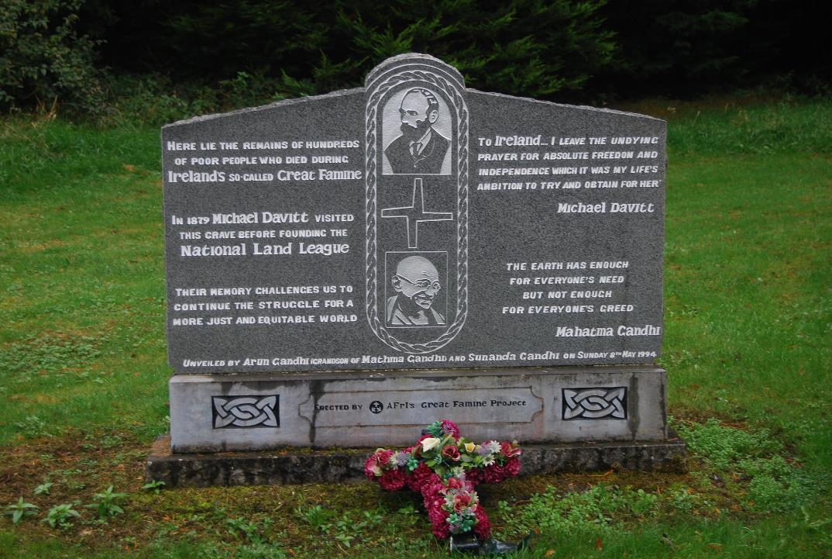
Swinford “Famine” Memorial,
Co. Mayo, 1994

Slide 14
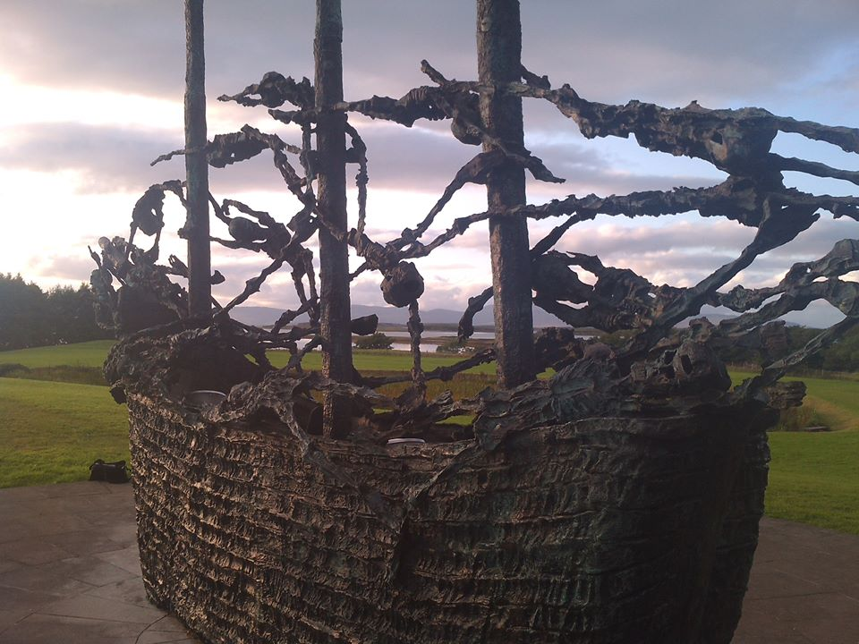
Murrisk, Co. Mayo
(National Famine Monument,
John Behan, 1997)

Slide 15
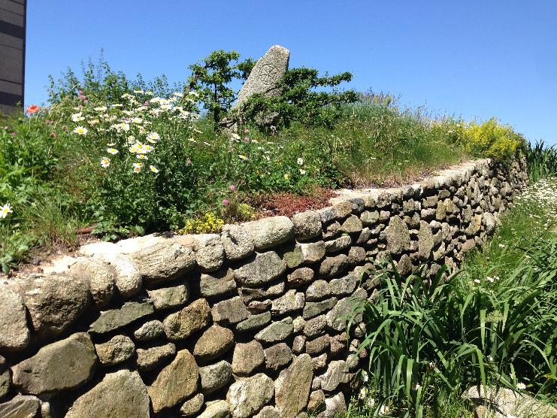
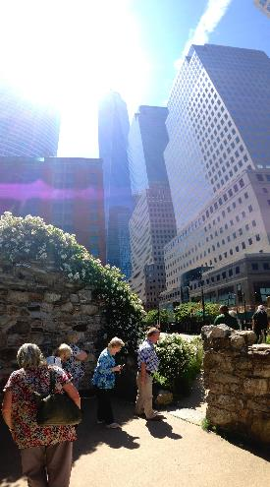
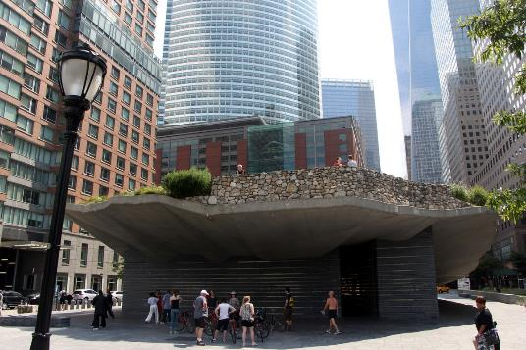
Irish Hunger Memorial, Battery Park, NYC
(Brian Tolle, 2002)

Slide 16
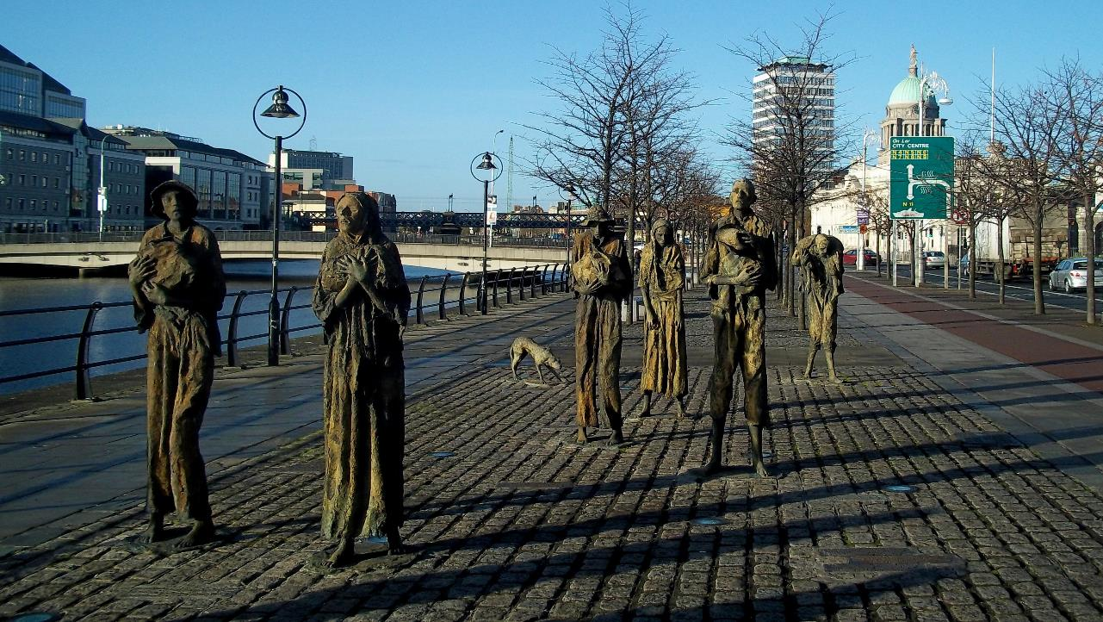
Dublin
“Famine”
(Rowan Gillespie, 1997)
Significant metropolitan sites: e.g. NYC, Boston etc.
Equivalent would be e.g. at Kauppatori in Helsinki.
“Sites of Memory” in e.g. Helsinki, Espoo, Tampere.
Lahti the largest municipality with a memorial.
Hämeenlinna arguably the most accessible?
Where would a Finnish “National” Famine Memorial be?

Slide 17
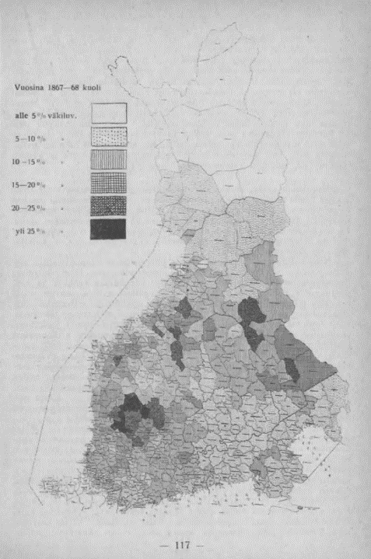
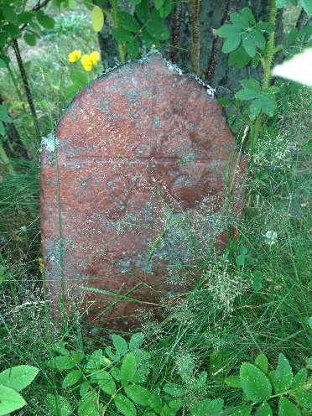
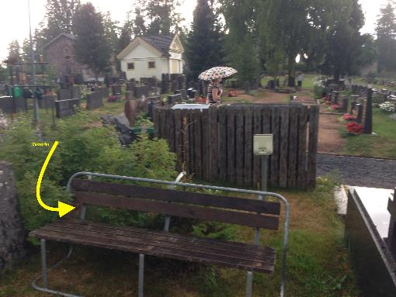
Parkano 1868 Memorial
(Pirkanmaa)
Parkano
‘Nälkävuodet 1867-68’, Edvard Gylling, 1917.

Slide 18
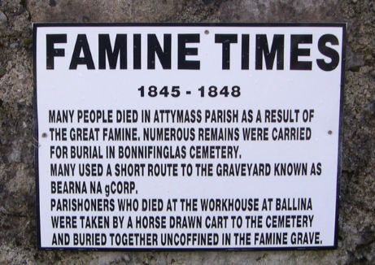
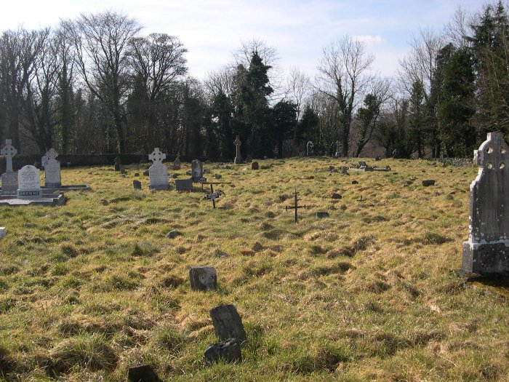
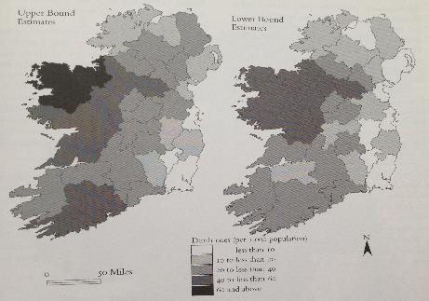
Bonnifinglas Cemetery, Attymass, Co. Mayo
Attymass

Slide 19
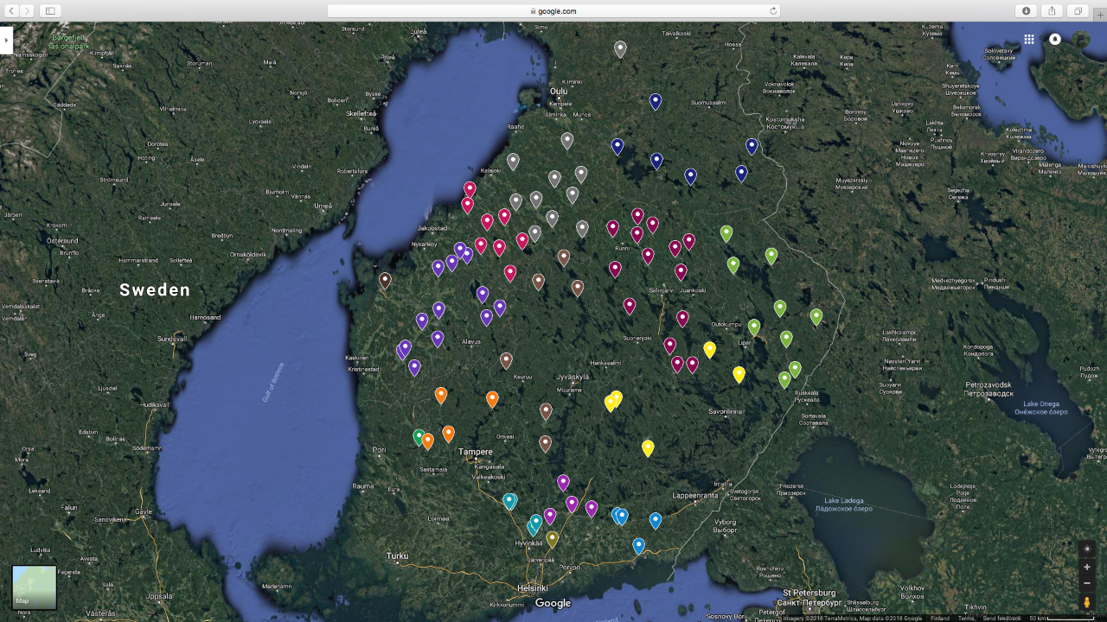
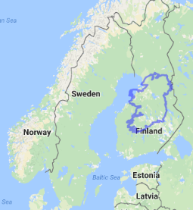
“Great Hunger Years” Memorials
Locations (by province) 30 Sep. 2018

Slide 20
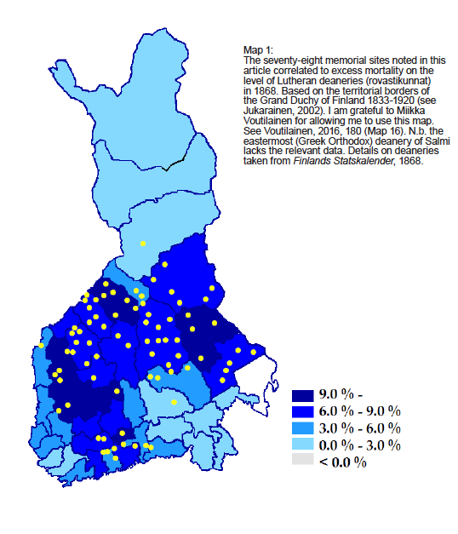
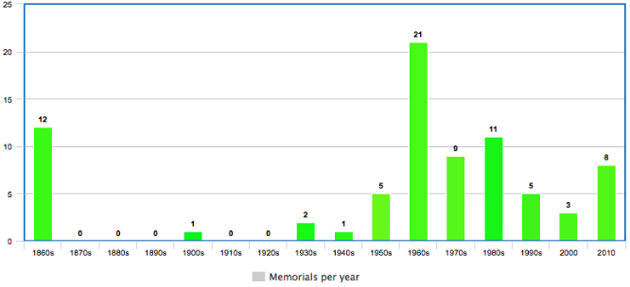
Table 1:
Chronological distribution of “Great Hunger Years” memorials with known “inauguration” dates.
NB some older stones are “rededicated” later.
Ilona Pajari’s idea of WWII as a “watershed” in Finnish commemorative culture.
Clear spike in the centenary decade.
Some anecdotal evidence to suggest a link between 1980s activity and e.g. Ethiopia famine.
Local motivations are also important (e.g. neighbouring parishes)
Huge contrast with Ireland re: 100th / 150th anniversary activity.
Pudasjärvi, Pohjois-Pohjanmaa
Ristiina, Etelä-Savo
Excess Death Rate 1868

Slide 21
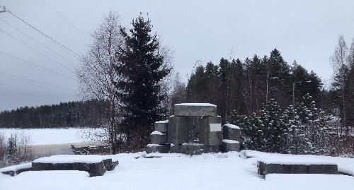
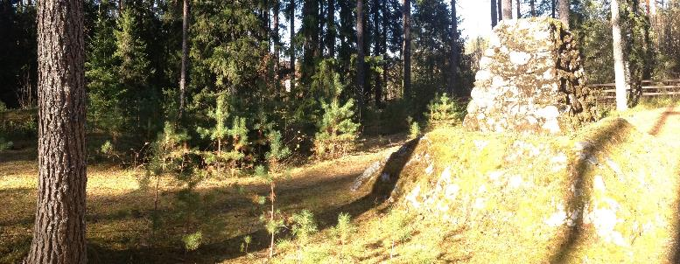
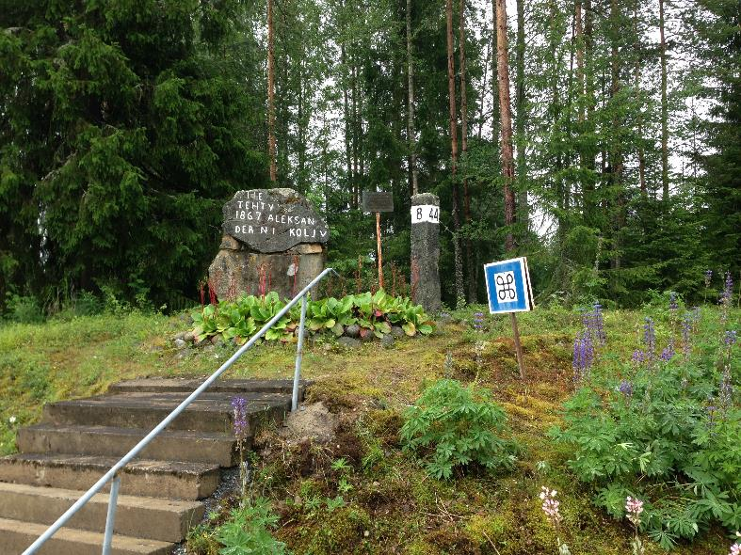
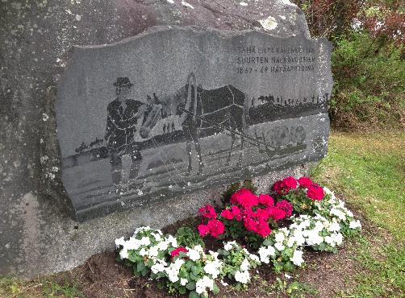
“Great Hunger Years” Memorials – Relief Works Sites
Kivijärvi (K-Suomi); Varkaus (P-Savo)
Viitasaari (K-Suomi); Tokerotie (E-Pohjanmaa)

Slide 22
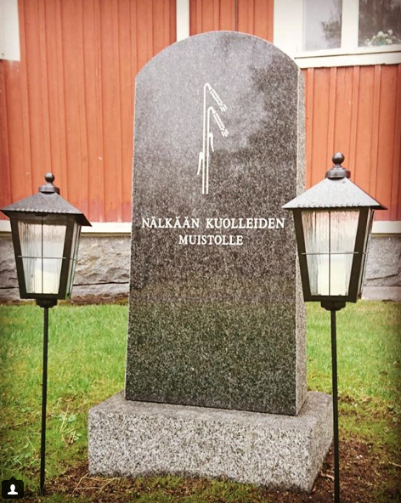
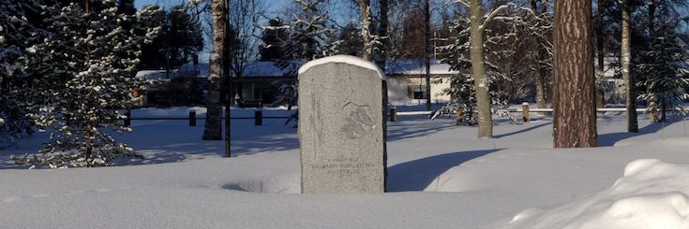
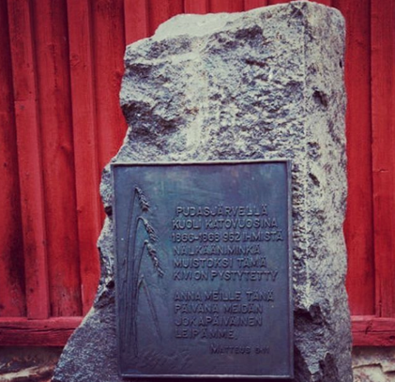
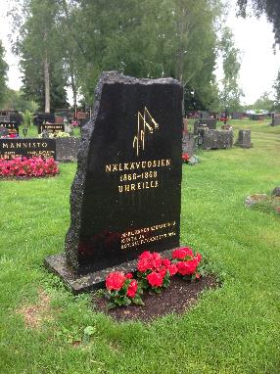
“Great Hunger Years” Memorials – Rye Motif
Paltaniemi (Kainuu); Kortesjärvi (E-Pojhanmaa)
Pudasjärvi (P-Pohjanmaa); Merijärvi (P-Pohjanmaa)

Slide 23
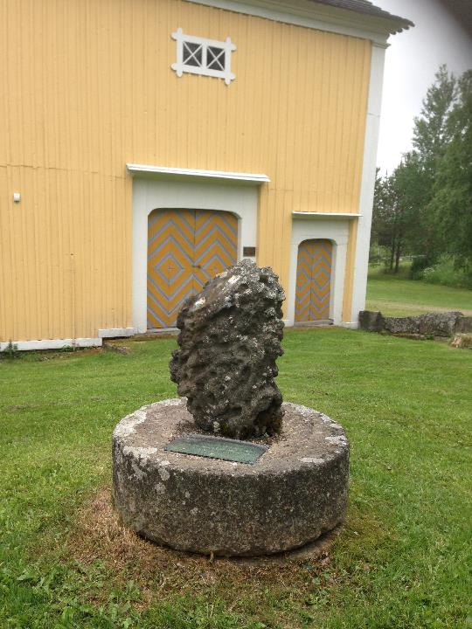
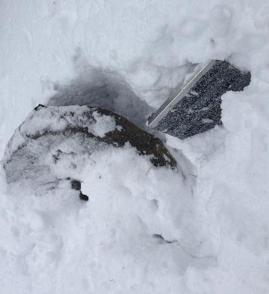
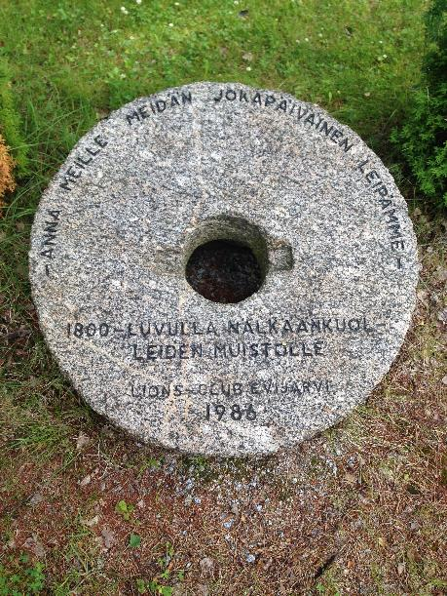
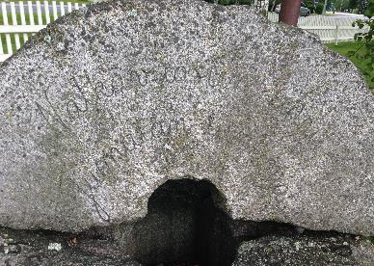
“Great Hunger Years” Memorials – Quern-stones
Sonkajärvi (P-Savo); Evijärvi (E-Pohjanmaa)
Ilmajoki (E-Pohjanmaa); Haapavesi (P-Pohjanmaa)

Slide 24
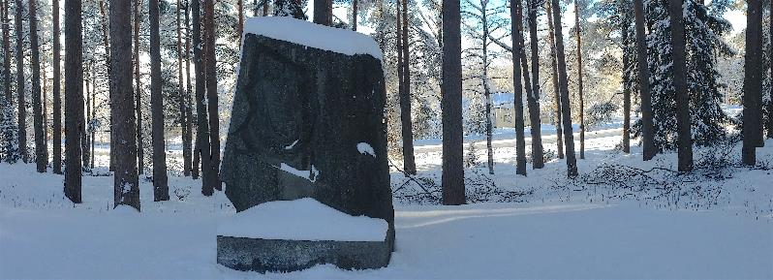
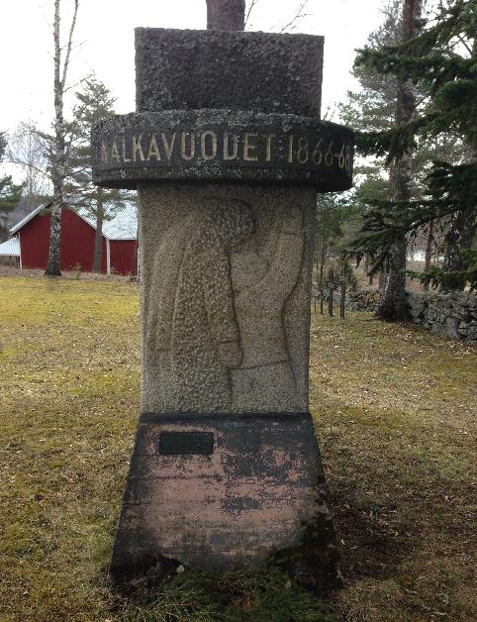
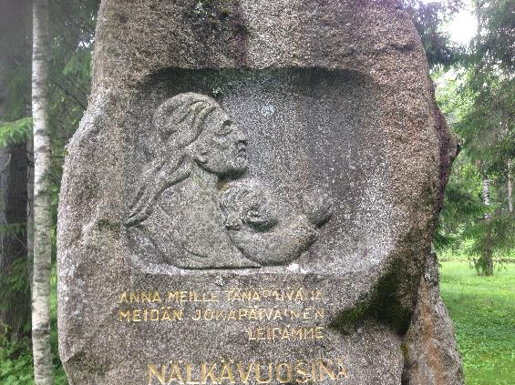
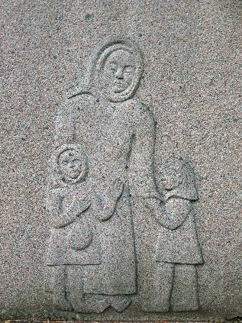
“Great Hunger Years” Memorials – Mother Motif
Lavia (Satakunta); Nurmes (P-Karjala)
Lehtimäki (E-Pohjanmaa); Kitee (P-Karjala)

Slide 25
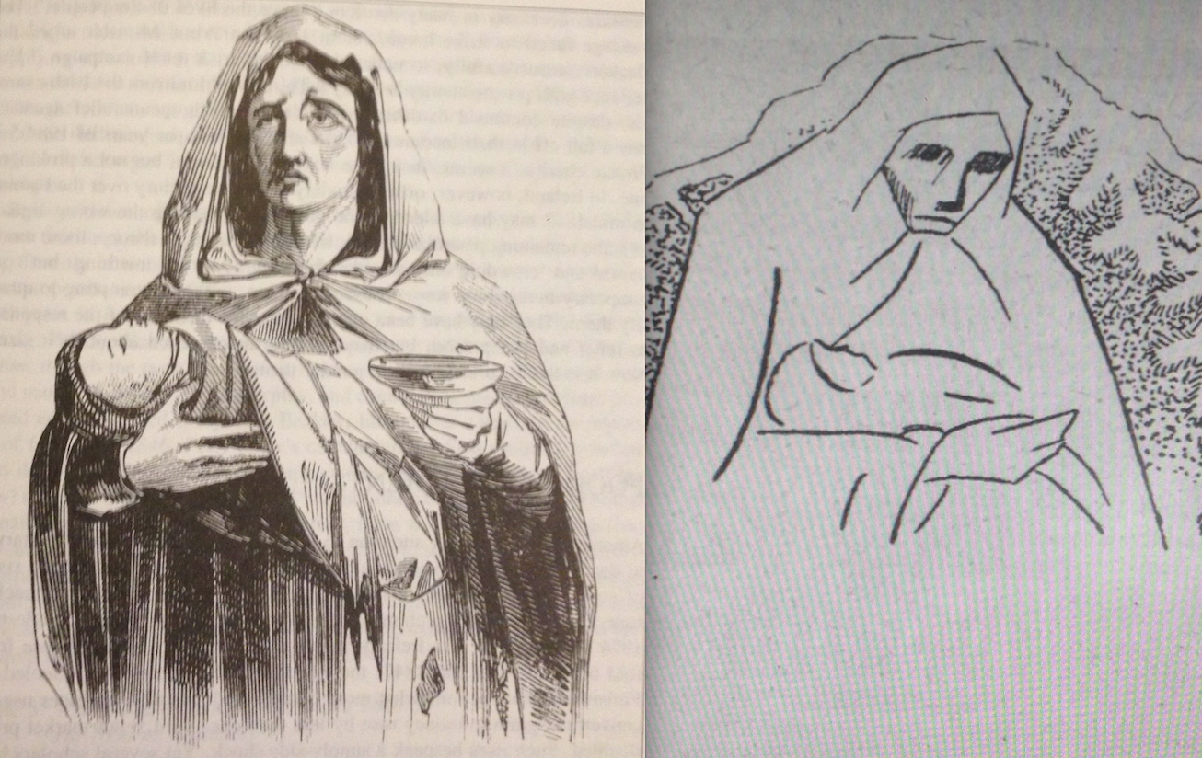
The well-known image by James Mahony of a ‘Woman Begging At Clonakilty’ (left, Illustrated London News, 13 February 1847), and the image that accompanied Edvard Gylling’s ‘Nalkävuodet 1867-68: Puolivuosisataismuisto’ [‘The Hunger Years 1867-68: A Semicentennial Recollection’] (Työväen Kalenteri, XI, 1918).

Slide 26
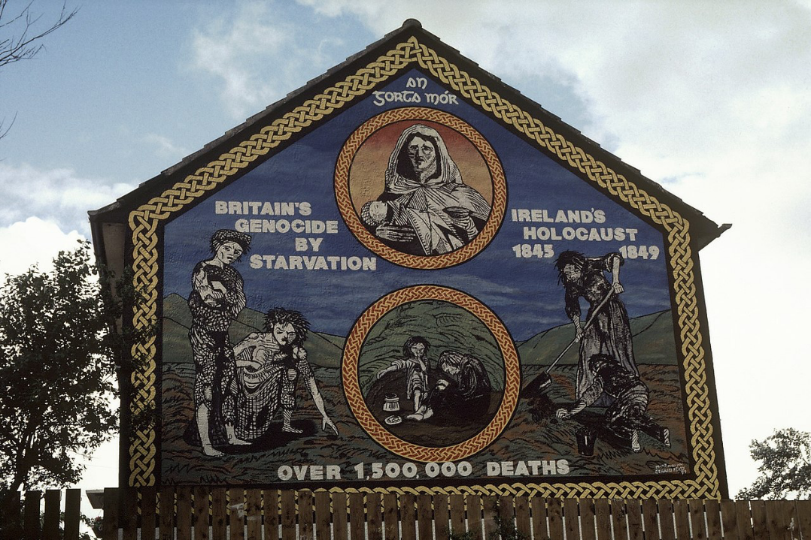
Ballymurphy, West Belfast.

Slide 27
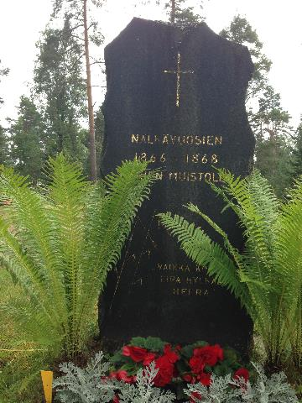
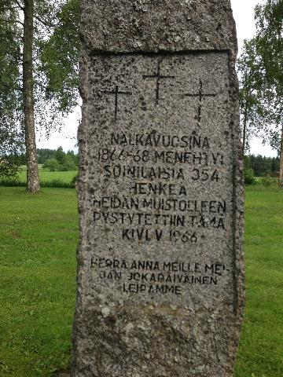
“Great Hunger Years” Memorials – “An Uninflammable People”?
Sievi (K-Pohjanmaa); Soini (E-Pohjanmaa)
⬅Peter Seddon “Memories Construct A Different Picture” (1987)
Croick Chapel, Kincardine. Scotland: “Glencalvie people was in the churchyard here May 24 1845”➔

Slide 28
“Great Hunger Years” Memorials – Mass Grave Sites
Pielavesi (P-Savo); Rautavaara (P-Savo)
Nilsiä (P-Savo); Varpaisjärvi (P-Savo)

Slide 29
Many of Jaakko’s comrades followed him in to frosty soil of churchyard the next troublesome weeks, but death had lost its meaning in minds of the living. No one was afraid of it when it revealed its ruthless grin, not to mention when it stroked someone else. Life was grim and hopeless. Constantly-gnawing hunger numbed the most sensitive of the feelings. Death was the only liberator from the seemingly endless misery. That is why people weren’t afraid of it. I dedicate these few incomplete rows as some kind of a monument for this victim of the hunger winter, whose final place of rest at Jänkäharju cemetery was never marked even with a simple wooden cross.
Väinö Laajala, SKS 5,1932, Perho
“Pajukon Jaakon viimeinen kuperkeikka”
(Muisto talvella 1867-68)
“Great Hunger Years” Memorials – Mass Grave Sites
Perho (Jänkäharju), S. Ostrobothnia – July 2017

Slide 30
“Great Hunger Years” Memorials – “Skeleton Track” [Luurata]
Map from Hufvudstadsbladet, 17 Feb. 1868.
“Arwokkaampaa hautapatsasta kuin Riihimäen-Pietarin rautatie ei ole kansamme woinut meidän nimettömille kaatuneillemme pystyttää.”
Agaton Meurman, Nälkäwuodet 1860-luvulla (Helsinki, 1892), pp. 44, 78.

Slide 31
“Great Hunger Years” Memorials – “Skeleton Track” [Luurata]
Hikiä (Hausjärvi); Oitti (Hausjärvi), Uusikylä (Nastola); Lahti

Slide 32
When was the Great Finnish Famine?
Margaret Kelleher has argued that the ‘long duration of the Irish famine makes it exceptional in international terms’, adding that the Finnish case was one of several well-known catastrophes that only lasted for a single year.
Margaret Kelleher, ‘The Irish Famine: History and Representation,’ in Mary McAuliffe, Katherine O’Donnell and Leeann Lane (eds.), Palgrave Advances in Irish History (London: Palgrave, 2009), p. 87.
Ullava 1865-1868
Pihlajaveden Erämaakirkko 1862-1867
Lohtaja 1867-1869
Tohmajärvi 1865-1868

Slide 33
CONCLUSIONS (1)
“No need for other memorials” – the persistent Fennoman interpretation of Finnish history.
Part of a “building block” approach. Proximity of “hero graves”, and see e.g. “Hard Times” memorial at Asikkala.
Recovery of population & association with rural reform.
A “Red” victory in 1918 would arguably have changed the memory of the famine?
Any Finnish “amnesia” (Mary Daly) is usually wilful, and highly selective.
In Finland the “sacred responsibility” is generally towards local victims and relatives – but their individual tales can also be absorbed into the larger national story (sacrifice). But no “other” (external or internal) as in Ireland.
Capriciousness of History – Independence achieved exactly 50 years later. Civil War immediately follows.
Commemoration of Famine Years always competing for attention (and funding) at notable anniversaries?
(White) Civil War Graves, Winter War, Evacuation of Karelia – all more “noble” and worthy of remembrance?

Slide 34
CONCLUSIONS (2)
“Sliding towards calamity” – local interpretations of the length of the crisis (1862-1869).
Here the memorials are like pixels in an old TV set, creating a larger picture?
Role of the state church: ambiguous? Maintaining memory – and overwhelmingly the main sites for these memorials - but also preaching acceptance of hardship as part of national identity. Highlights the “power of God”.
Subsuming local experience beneath a national-level narrative.
Ireland: significant change in emphasis post-1997.
Vigorous memorialisation among Irish communities outside of Ireland (absent in Finnish case).
Previously it had also been suggested that Ireland suffered from “famine amnesia”.
Blair apology / GFA Context
Association with other “oppressed” peoples and contemporary famines, but also with historical calamities such as the Holocaust and the Ukrainian Holodomor.
For an Irish nationalist, a “famine” could not be caused by nature alone; for a Finnish nationalist, “nature” was the main cause. The extent of self-government in Finland is a key factor in the differences in commemoration.

Slide 36
Select Bibliography
Articles:
Andrew G. Newby, “‘Acting in their appropriate and wanted sphere’: the Society of Friends and Famine in Ireland and Finland, c. 1845-68”, in C. Kinealy, P. Fitzgerald & G. Moran (eds), Irish Hunger & Emigration: Myth, Memory and Memorialization (Quinnipiac, Quinnipiac UP, 2015), pp. 107-20, 190.
Andrew G. Newby, “Finland’s ‘Great Hunger Years’ Memorials: A Sesquicentennial Report”, in Andrew G. Newby (ed.), “The Enormous Failure of Nature”: Famine and Society in the Nineteenth Century (Helsinki: CollEgium, 2017), pp. 173-214.
Andrew G. Newby, “Overcoming Amnesia? Memorializing Finland’s ‘Great Hunger Years’, in M. Corporaal, O. Frawley & E. Mark-Fitzgerald (eds), The Great Irish Famine: Visual and Material Culture (Liverpool: Liverpool UP, 2018), pp. 183-206.
Blog: http://www.katovuodet1860.wordpress.com
Instagram: @finnishfaminememorials
Videos & Documentaries:
“The Finnish Famine Has Not Been Forgotten” [Academy of Finland]
“Looking For Monuments of Famine” [University of Helsinki / Unitube]
“On The Trail of Famine Memorials in Finland” [YLE Areena]

