Slide 1
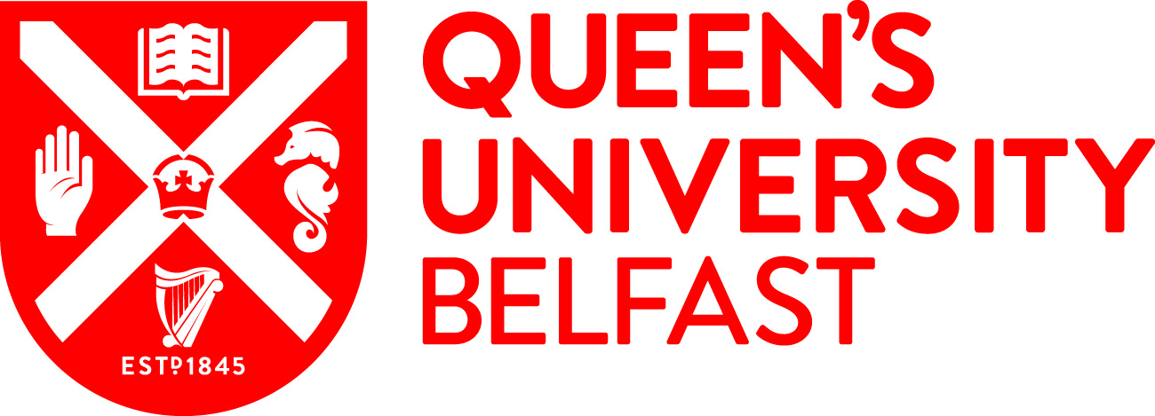
Irish Nationalism and Republicanism
An Overview
Dr Cathal McManus
c.p.mcmanus@qub.ac.uk
@CathalPMc
School of
Social Sciences,
Education and
Social Work

Slide 2
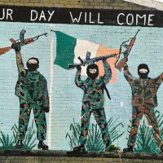
Introduction
Historical Context to modern Republicanism
Political Aspirations of Irish Nationalism/Republicanism
Peace Process and Brexit Question

Slide 3
Nationalism, the most potent modern principle of political legitimacy, is the doctrine that the nation should be collectively and freely institutionally expressed and ruled by its co-nationals. It also stipulates that the nation must choose how it rules itself. Nationalism is therefore a democratic doctrine of political legitimacy. Nationalism should not be conflated with ethnicism, the doctrine that the nation consists of just one ethnic group, or statism, the doctrine that the state defines the nation – though both ethnicism and statism have disfigured Irish and British nationalism, and continue to do so. Nationalism entails identification with a community and the belief that the national community requires political institutions for its defence or expression…It does not require all nations to seek independent statehood, but it does require that members of the nation consent to the form of government under which they live and express themselves, because without such consent they would not be free.

Slide 4
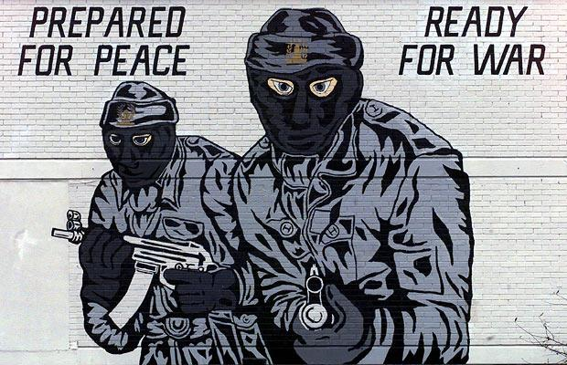
This is the meaning of the doctrine of national self-determination. In Northern Ireland rival nations and rival understandings of national self-determination have been locked in conflict.
John McGarry and Brendan O’Leary, Explaining Northern Ireland: Broken Images (Oxford: Blackwell Publishers, 1995) 13-14

Slide 5
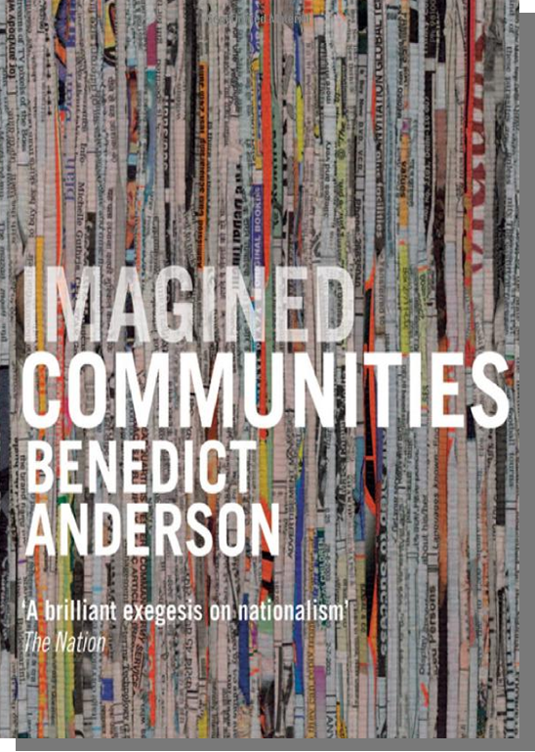
In an anthropological spirit, then, I propose the following definition of the nation: it is an imagined political community – and imagined as both inherently limited and sovereign.
It is imagined because the members of even the smallest nation will never know most of their fellow-members, meet them, or even hear of them, yet in the minds of each lives the image of their communion.
Benedict Anderson, Imagined Communities (London: Verso, 1991) 5-6

Slide 6
Historical Overview
Militant Movements
Constitutional Politics
Parliamentary Reform
Society of the United Irishmen 1790s - 1803
Daniel O’Connell
Young Ireland movement 1840s
Home Rule 1885-1921
Fenians/I.R.B. 1860s-1921
Sinn Féin 1905 - Current
Irish Republican Army 1919 - ?
Nationalist Party – SDLP

Slide 7
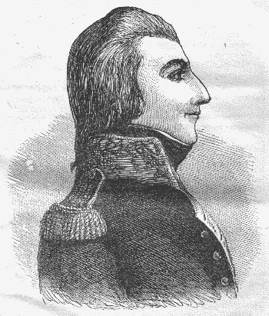
Theobald Wolfe Tone
To subvert the tyranny of our execrable government, to break the connection with England, the never-failing source of all our political evils, to assert the independence of my country – these were my objects. To unite the whole people of Ireland, to abolish the memory of past dissensions, and to substitute the common name of Irishman in place of the denominations of Protestant, Catholic and Dissenter—these were my means.

Slide 8
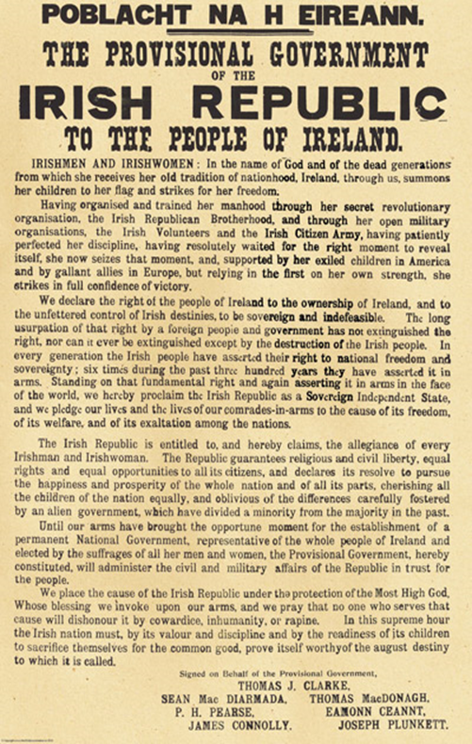
1916 Easter Rising
The Irish Republic is entitled to, and hereby claims, the allegiance of every Irishman and Irishwoman. The Republic guarantees religious and civil liberty, equal rights and equal opportunities to all its citizens, and declares its resolve to pursue the happiness and prosperity of the whole nation and all its parts, cherishing all the children of the nation equally, and oblivious of the differences carefully fostered by an alien government, which have divided a minority from the majority in the past.

Slide 9
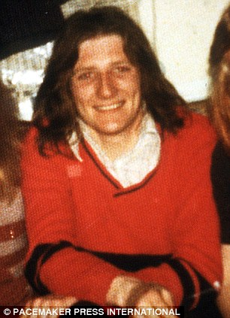
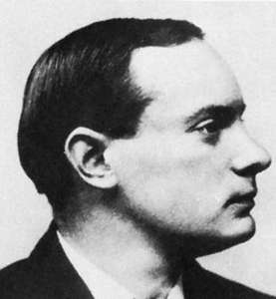
“Ireland Unfree Shall Never be at Peace”
Each generation fights – sacrifices – for Irish national independence.
“…they have left us our Fenian dead, and while Ireland holds these graves, Ireland unfree shall never be at peace”.

Slide 10
Complex Politics
At the heart of the Republican ideal is the idea of the majority Catholic and minority Protestant populations being reconciled.
Republicans argue that it is the British that have helped to create and sustain divisions between the two communities.
Historically subscribed to the idea that “Ulster Protestants” are Irish – become comfortable with that label once Irish independence has been granted.

Slide 11
Complex Politics
Two key considerations:
Violence used by republicans to advance their cause has further alienated Protestants from the national ideal – heightened their fears.
Historically, Protestants have held an Irish identity – not necessarily the Gaelic Irish identity that often dominates contemporary Irish republican thinking: romantic/cultural nationalism.
Sets Republicanism apart from contemporary constitutional nationalists – those that argue for a degree of reconciliation leading to Irish independence.

Slide 12
Constitutional Nationalism
Historically, constitutional nationalism has not sought a total separation from Britain:
Home Rule sought to achieve a form of devolution
SDLP continue to argue for power-sharing in NI – accepted that the constitutional position of NI can’t change unless majority support.
Position that has had political support amongst the Catholic population:
Home Rule had popular support between 1886-1918
SDLP largest nationalist party in Northern Ireland through the 1972-2000 period – Sinn Féin only after the Agreement.

Slide 13
Complex Politics
Reinforced by Catholic attitudes towards the Union and Irish Unity.
Catholic population in Northern Ireland seem relatively content with the status-quo – power-sharing at Stormont.
They continue to identify as Irish – predominantly Irish nationalist.
Agreement has facilitated and legitimised their Irish identity and citizenship – generated a degree of contentment?

Slide 14
Northern Ireland Life and Times: “Long-term policy for Northern Ireland should be…” – Catholic population

Slide 15
Which, if any, of the following best describes how you see yourself? – Catholic Community

Slide 16
Catholics as “Nationalists” Vs Support for Irish Unity

Slide 17
The Brexit Scenario
British and Irish membership of the EU allowed for the normalisation of society – border region after the conflict.
Security and customs posts disappeared – helped to make the border invisible.
Brexit has raised new issues in relation to the border – need for a hard border?
Also raised questions about the rights of Irish citizens in Northern Ireland in relation to the EU – NI vote to remain.

Slide 18
The Brexit Scenario
Fears that Brexit could play into the hands of “Dissident” Republicans who oppose the peace process.
Groups such as the “Real IRA” and “New IRA” continue to advocate a military struggle against British rule in Ireland – lack support.
Fear is that Brexit could undermine progress of the peace process – politics not working.
Collapse of Stormont in 2017 and opposition to Irish Language Act.

Slide 19
Lucid Talk/BBC Online Poll (May 2018)
“Has the United Kingdom’s decision to leave the EU i.e. Brexit - changed your mind on the constitutional position of Northern Ireland (NI)?”
28% of respondents answered “Yes – I used to support NI staying the UK, but I may/would now support NI joining the Republic of Ireland”.
21% of Protestants and 31% of Catholics polled had changed their minds in favour of a United Ireland whilst 41.3% of “Other/No Religion” had done likewise.

Slide 20
Irish Nationalism Revived?
Brexit has created new questions about the future of Northern Ireland – position within the UK.
If northern Catholics had grown content with the political situation this has now been challenged.
Catholics were much more supportive of EU membership – 85% of Catholic voters voted to remain.
Questions about the type of Union that will now exist.

